Slide 1
Windows Server Services
Cybersecurity
Lesson 7.4

Slide 2

Learning Objectives
By the end of today’s class, you will be able to:
1
Understand Task Scheduling in a Windows Environment
2
Configure Windows Update on Windows Computers
3
Understand the Windows Attack Space

Slide 4

Recap
Windows Administration and Hardening
Day 1
Day 2
Day 3
We used PowerShell to navigate and manage the Windows system directories and files.
We secured our domain using group policy.
We deployed Windows Defender to secure against malware threats.

Slide 6
Recap of previous class
We used Powershell to navigate and manage the Windows system directories and files
We secured our domain using group policy
We deployed Windows Defender to secure against malware threats

Slide 7
Today, we're going to learn how to Protect Windows Services and Schedule Tasks.

Slide 8
Task Scheduler is a GUI tool to automate scripts and applications in a Windows environment

Slide 9
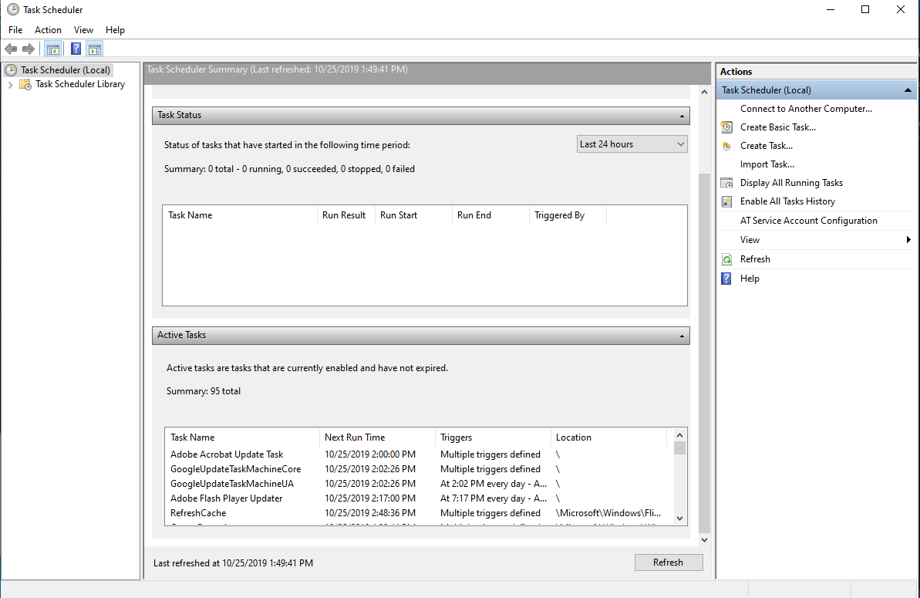

Slide 10
Windows Tasks are similar to cron jobs in Linux

Slide 11
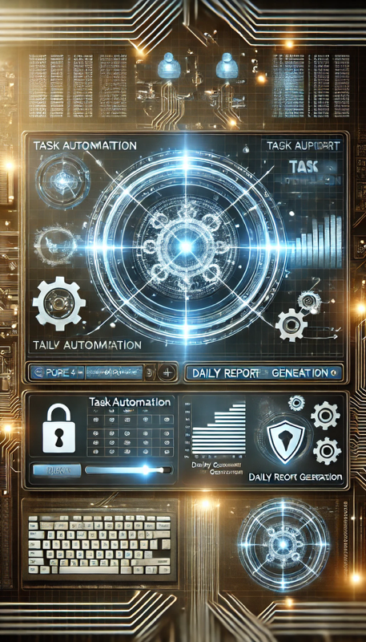
Scheduling Tasks
Imagine the following scenario:
Your CEO wants to schedule reports to be created daily.
The systems isn’t remotely managed at this time.
We can use the Task Scheduler to create a task that will do this.

Slide 12
Task Scheduling

Slide 13
Task Scheduling
15 Minutes

Slide 14

Public Key Infrastructure (PKI)

Slide 16
Windows Updates and Enterprise Management

Slide 17
Updates are the backbone of a secure and reliable IT environment.
Updates provide critical patches against vulnerabilities and performance improvements

Slide 18
But… patches often go ignored. Why?

Slide 19
Common reasons for ignoring updates
Time - Systems are expected to up continuously, but patches often require rebooting.
Compatibility - Many services on a Windows server are highly-dependent on other sources. Updating one can affect others.
Broken Patches - Even though patches are tested extensively, there are many variations in hardware and software that can cause issues that may be unnoticed until the patches go to production machines.
Limited Resources - Even if the patch is critical, if the system currently works, techs might delay its deployment.

Slide 20
SCCM and BCM to the rescue!

Slide 21
System Center Configuration Manager (SCCM) is the cornerstone of enterprise IT by automating and customizing updates and monitoring compliance across the network.

Slide 22
Business Continuity Management (BCM) focuses on maintaining operations during disruptions

Slide 23
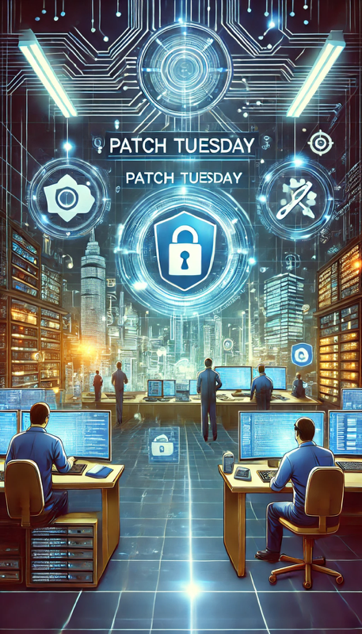
Patch Tuesday
Occurring on the second Tuesday of each month, Microsoft releases patches for vulnerability and performance enhancements.
While this schedule provides predictability, allowing for organizations to prepare in advance, Patch Tuesday also underscores the importance of staying current.

Slide 24
Configuring Windows Updates

Slide 25
Managing Updates with SCCM
Create a new Software Update Group
Select updates from the catalog aligned with compliance policies
Deploy updates to test environment
Schedule deployment to live environment
Monitor compliance using SCCM reporting features

Slide 26
Automatically Applying Patches
15 Minutes

Slide 30
Understanding Windows
Attack Vectors

Slide 31
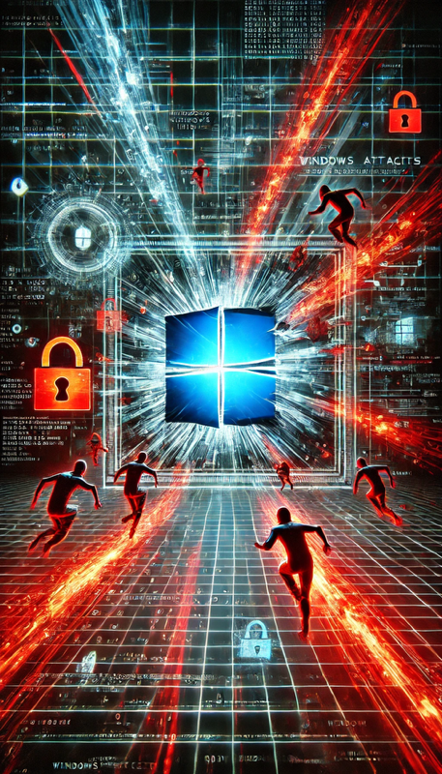
Windows Attack Vectors
Windows is a target-rich environment for attackers.
Users, by necessity, often have access to critical files
Attackers exploit this by blending in with legitimate processes, hiding in common locations, and leveraging elevated privileges

Slide 32
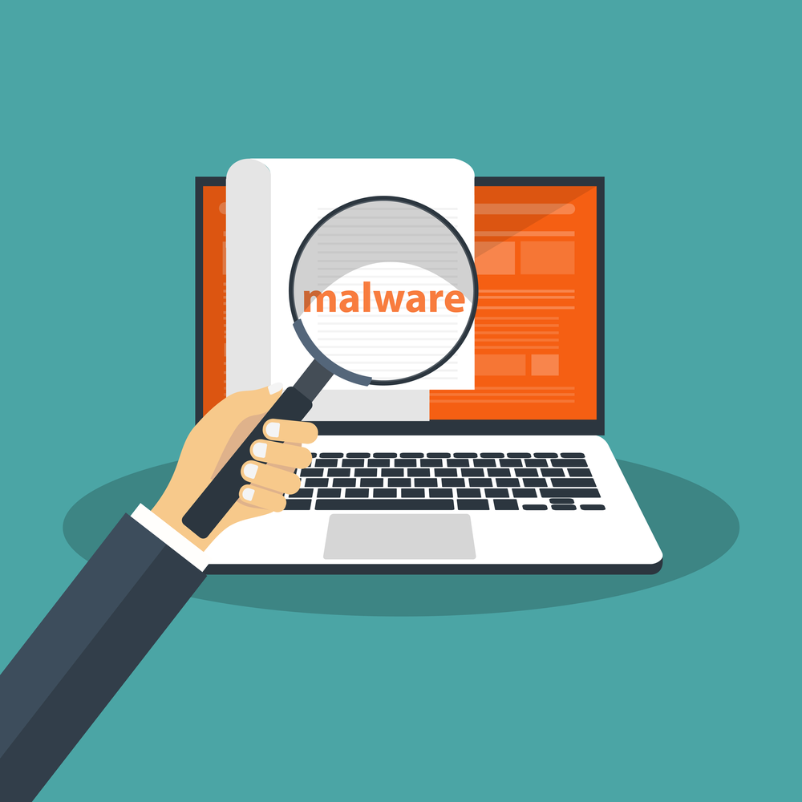
Regular User with Local Admin
It starts with a phishing email, but that can lead to opening the floodgates to a full-blown breach!
Attackers rely on error or oversight
Embedding payloads in temp folders
Scheduled tasks
Hidden AppData directories
By blending in with the environment, malware remains undetected

Slide 33
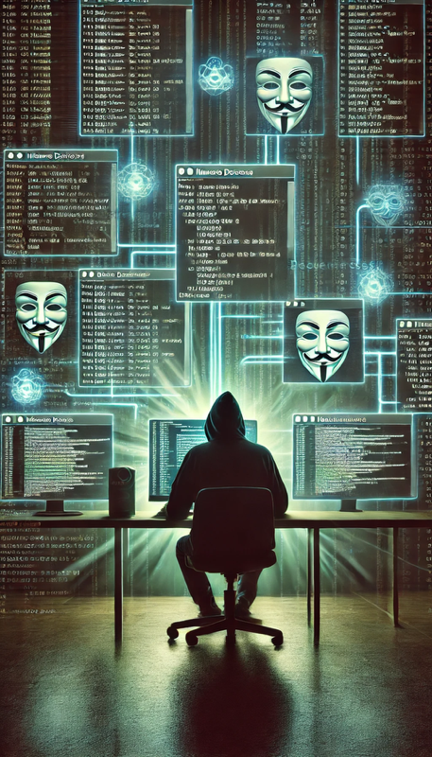
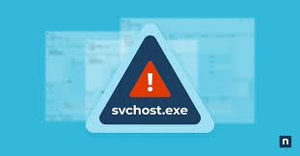
Malware Developers
Over time, developers have become adept at disguising their creations by naming malicious processes to blend in.

Slide 34
User Space Attacks
Imagine a scenario where a seemingly legitimate service is consuming unusually high CPU cycles.
At first glance, the process name suggests that it is a system service
Let’s uncover this hidden threat.

Slide 35
User Space Attacks

Slide 36
Investigating User Spaces and Services
20 Minutes

